Slide 1
Sentiment and Video Assistant Referees in Premier League Soccer
Dylan Blechner, Syracuse University

Slide 2
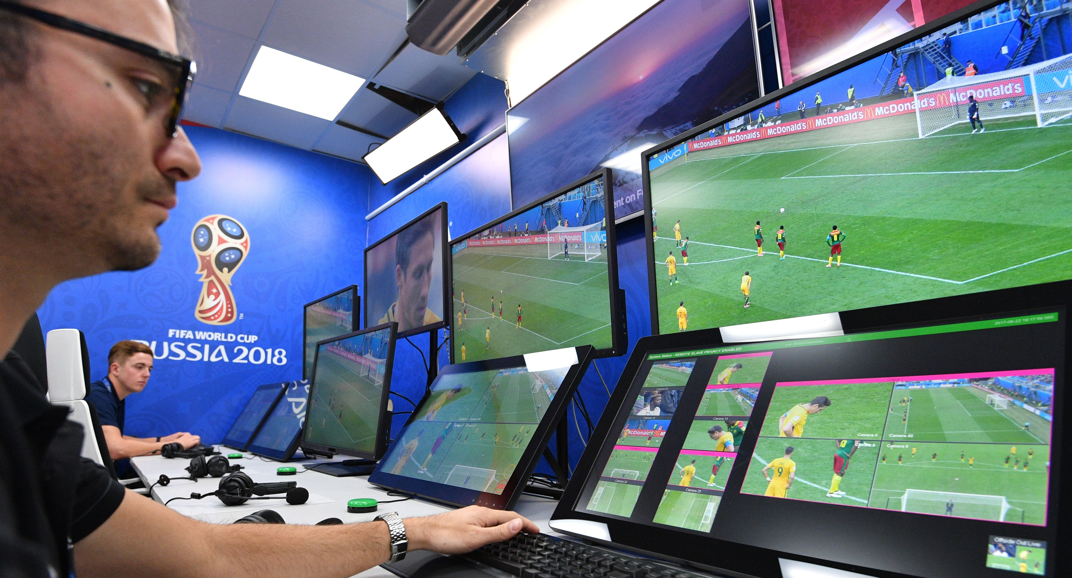

Introduction
Video Assistant Referee(s) (VAR) – off-field match official that reviews calls made or missed by the head on-field referee with the assistance of replay technology

Slide 3
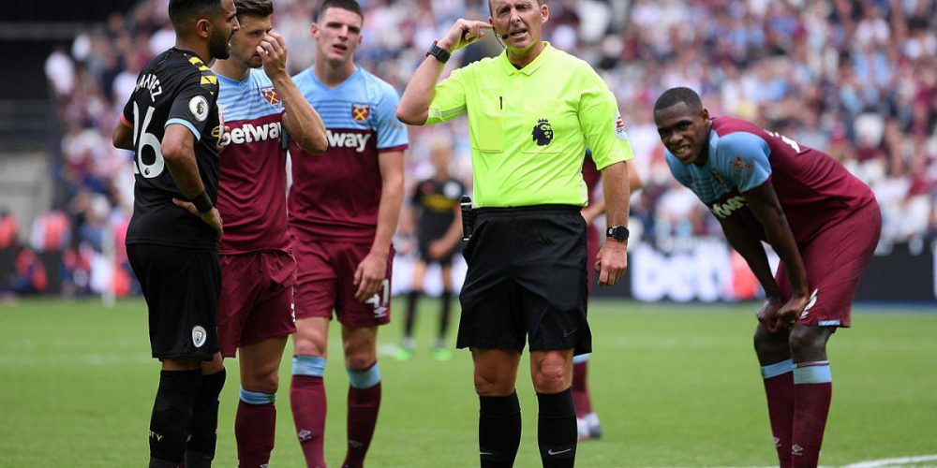
Introduction
Hypotheses:
VAR decisions during professional soccer matches increase social media activity
Sentiment of tweets about VAR decisions is more negative rather than positive or neutral

Slide 4
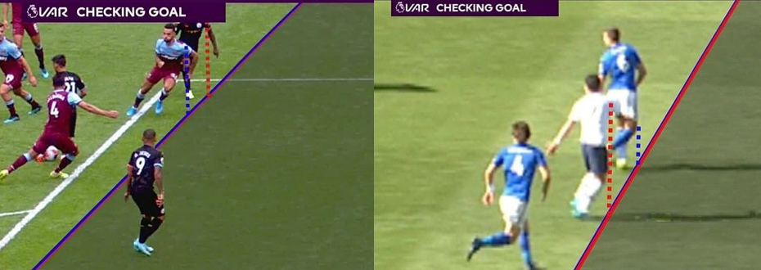
Literature Review: Non-Academic Sources
Many articles have discussed the use of VAR in various professional leagues and competitions
There has been considerable talk about the use of VAR in the English Premier League this season – first year the technology has been implemented

Slide 5
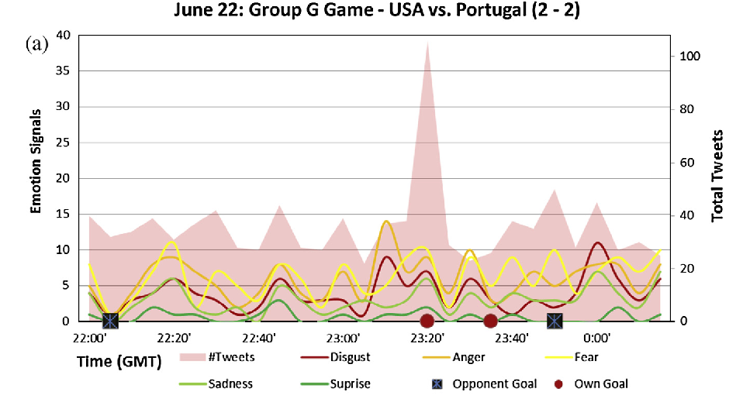
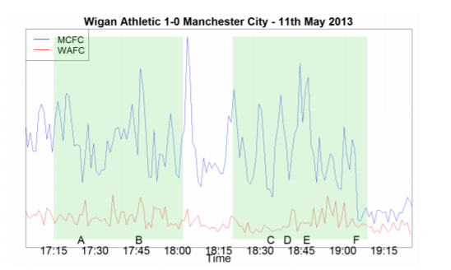
Literature Review: Sentiment Analysis in Soccer
Is it possible to determine whether or not a VAR call is “correct” by using fan sentiment?
Several papers have analyzed social media sentiment associated with soccer matches to quantify excitement related with specific game events

Slide 6


Data: Summary of Twitter Data
Twitter data gathered using the “twitterscraper” module in Python
2-Step Process
English tweets containing “var” or “#var” on each day a match was played during the first half of the 2019-2020 English Premier League Season
English tweets containing “var” and a game-specific hashtag on each day a match was played (e.g. "#LIVMCI" is the game-specific hashtag for a game between Liverpool and Manchester City)
Finally, information about the authors was gathered including the number of followers and location by using the "rtweet" package in R

Slide 7
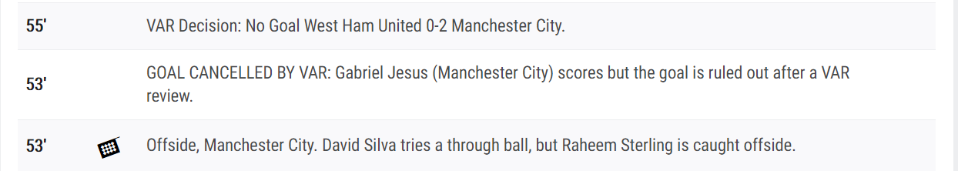
Data: Summary of Commentary Data
Commentary data gathered from ESPN using the “fcscrapR” package in R
Specifies information about key events that took place during a given match – including VAR decisions
VAR decisions were then separated into the four categories of decisions that can be reviewed: a goal, a penalty kick, a red card, and mistaken identity

Slide 8
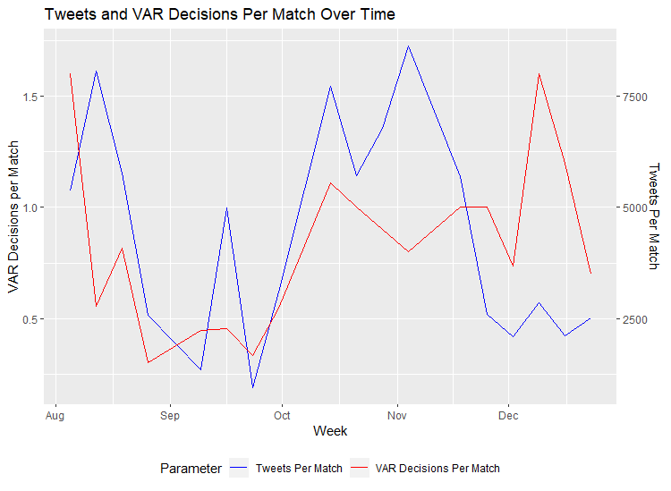
Data: Sentiment Analysis – Tweets vs. VAR Calls
805,548 tweets containing “var” or “#var” during the first half of the EPL season
How did fans feel about VAR as the season went on?
158 VAR calls made through 190 matches
Can analyze the relationship between number of VAR calls and number of tweets (R = 0.206)

Slide 9
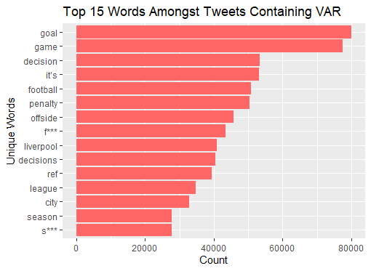
Data: Word Frequency Chart
Calculated frequency of words in tweets containing “var”
Tokenized terms by separating by spaces and removing common stop words

Slide 10
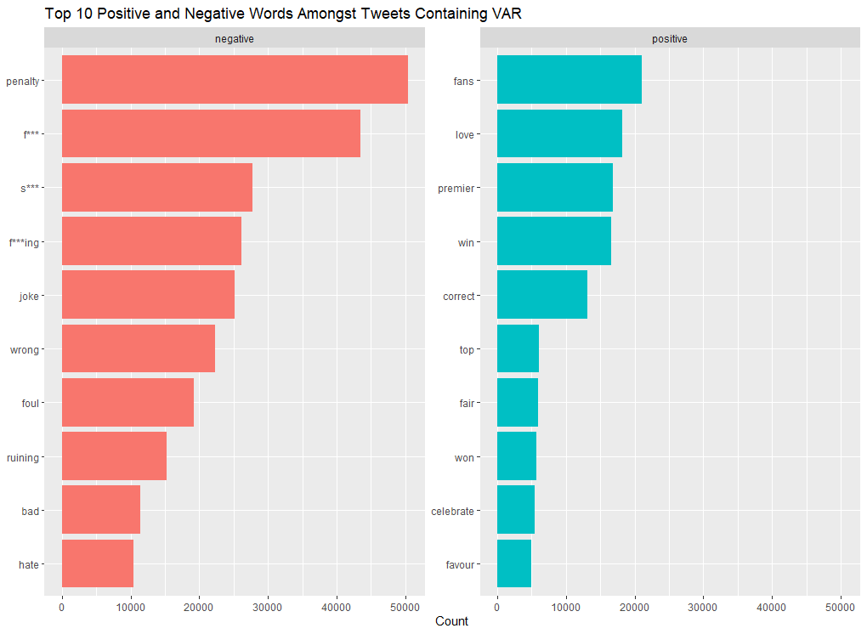
Data: Bing Sentiment Lexicon
Bing Sentiment Lexicon – categorizes 6,786 words as either positive or negative
Merged tokens with the Bing Lexicon to analyze the most frequent positive and negative terms
70% of terms were negative – same as Bing Lexicon itself which is made up of 70% negative terms

Slide 11
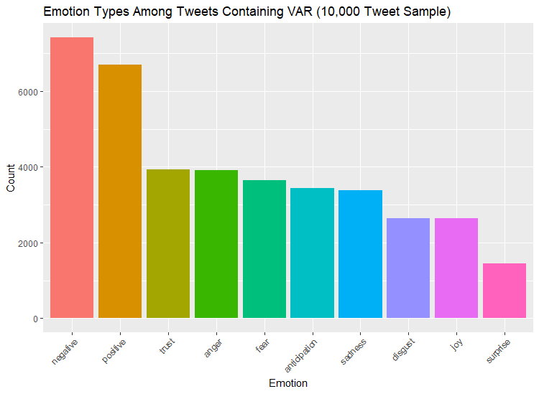
Data: NRC Sentiment Lexicon
NRC Sentiment Lexicon – categorizes words into 8 additional classes:
Anger, anticipation, disgust, fear, joy, sadness, surprise, and trust
Used random sample of 10,000 tweets

Slide 12
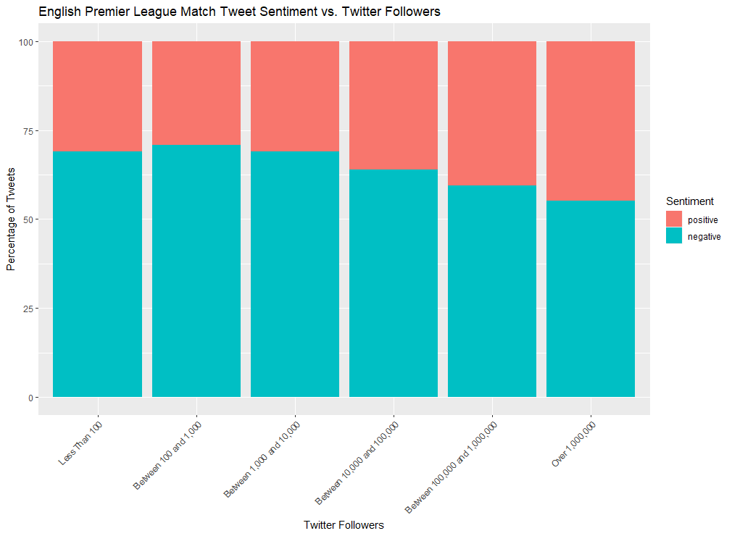
Data: Twitter Followers
Using the Bing Lexicon, I determined the percentage of positive and negative tweets for users in different bins of followers
More followers a user has, more positive they are about VAR

Slide 13
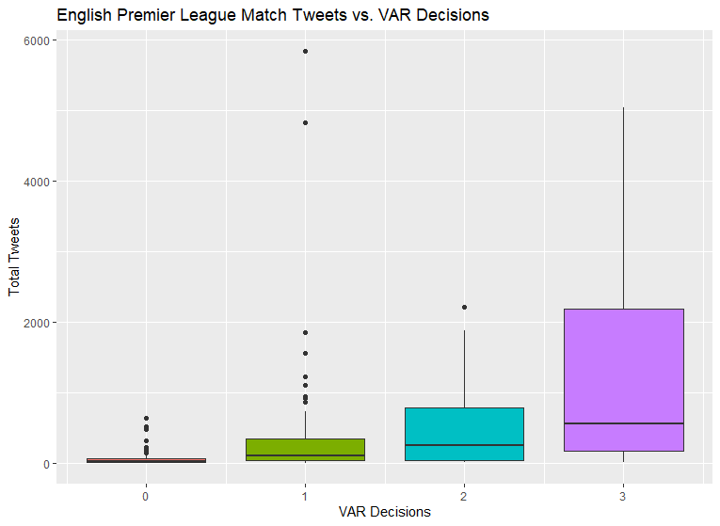
Data: Game-Specific Hashtags
61,127 tweets containing “var” and a game-specific hashtag
Can analyze how fans felt about specific VAR decisions during matches in the EPL
First looked at the relationship between the number of VAR calls in a match and the number of tweets

Slide 14
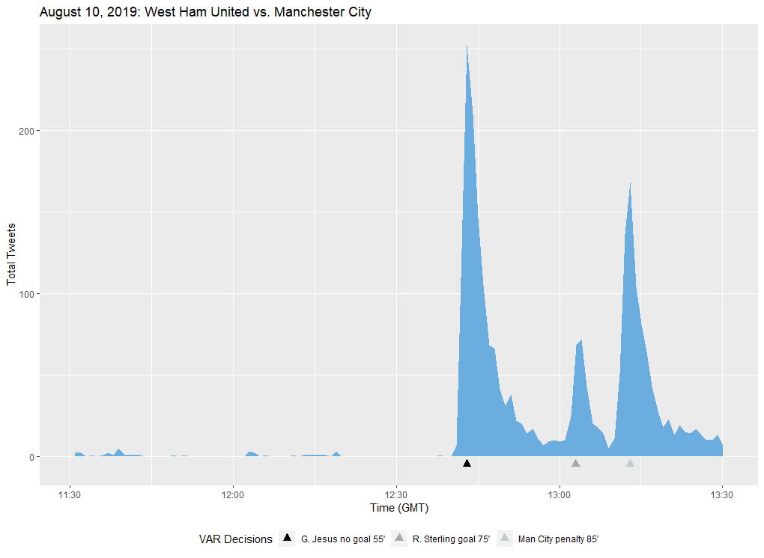
Data: In-Game Analysis (Number of Tweets)
By using Twitter data from specific games, we can evaluate whether a VAR call was the correct one
Manchester City vs. West Ham United – August 10, 2019
Can see spikes in Twitter activity after the VAR decisions

Slide 15
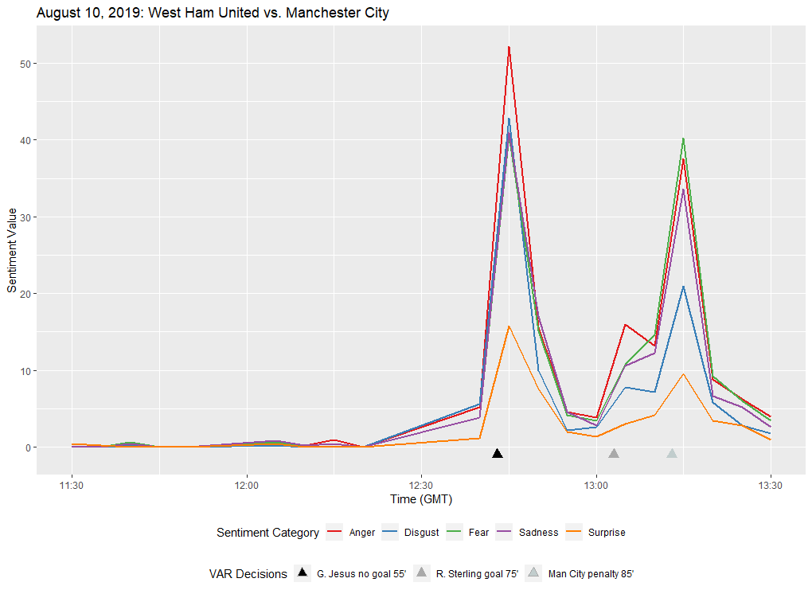
Data: In-Game Analysis (NRC – Negative)
Can go one step further by using the NRC Lexicon to evaluate positive and negative emotions during a match
Fans reached peaks of anger, sadness, and disgust after the first VAR decision
Reached high levels of fear after the last call

Slide 16
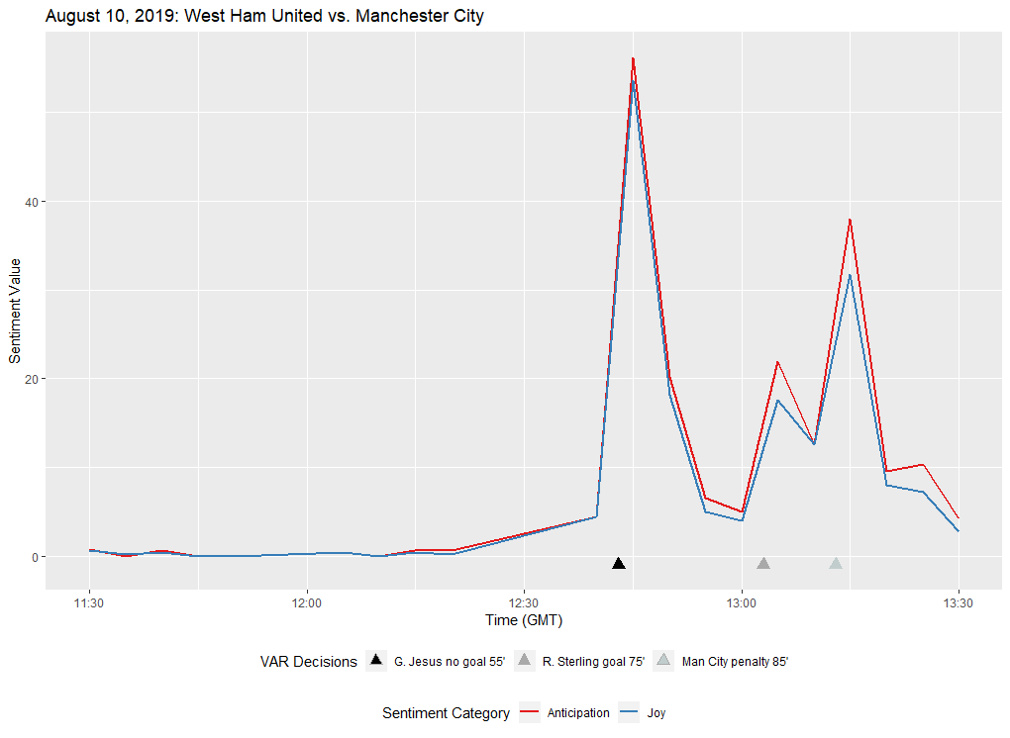
Data: In-Game Analysis (NRC – Positive)
Did not reach as high levels of positivity, but still shows the divide amongst fans
The second decision was met with more positive sentiment – shows that it may have been the correct call

Slide 17
Data: NLP Model Description
I wanted to utilize Natural Language Processing techniques to create a model to predict the sentiment of future tweets concerning VAR
Trained model using SemEval 2014 Twitter data – 10,000 tweets labeled as positive, negative, or neutral
Tokenized tweets and converted to lowercase
Used 1500 most common tokens as features
Filtered out English stop words, negation words (“not”, “no”) as well as common online chat abbreviations
Removed Twitter handles and hyperlinks
58% accuracy after preprocessing phase

Slide 18
Data: NLP Model Feature Engineering
Subjectivity Lexicon – analyzes polarity of subjective expressions
LIWC (Linguistic Inquiry and Word Count) Lexicon – lists positive and negative words similar to Bing Lexicon
VADER (Valence Aware Dictionary and sEntiment Reasoner) Lexicon – specializes in sentiment analysis for social media text
Each lexicon splits tokens into positive, negative, and neutral words (LIWC – only positive and negative)
Three features – “positivecount”, “negativecount”, “neutralcount”
If word appeared in one of the lexicons, one would be added to the corresponding sentiment feature

Slide 19
Data: NLP Model Most Informative Features
Split the tagged tweets so 90% were in the training set and 10% were in the test set
Ran a Naïve Bayes Classifier on the training data
30 Most Informative Features
Feature | Relationship | Feature | Relationship
f*** | neg : neu = 66.4 : 1 | negativecount = 9 | neg : neu = 19.5 : 1
:) | pos : neg = 51.4 : 1 | thanks | pos : neu = 19.4 : 1
fun | pos : neu = 49.5 : 1 | missing | neg : pos = 18.3 : 1
excited | pos : neu = 47.2 : 1 | negativecount = 10 | neg : neu = 18.1 : 1
sad | neg : neu = 43.9 : 1 | cool | pos : neu = 16.8 : 1
sorry | neg : neu = 43.9 : 1 | cant | pos : neu = 15.1 : 1
positivecount = 12 | pos : neu = 42.5 : 1 | brilliant | pos : neu = 15.1 : 1
great | pos : neu = 38.9 : 1 | funny | pos : neu = 14.2 : 1
happy | pos : neu = 35.7 : 1 | exciting | pos : neu = 14.2 : 1
amazing | pos : neu = 35.7 : 1 | wrong | neg : neu = 14.2 : 1
luck | pos : neu = 28.8 : 1 | hate | neg : neu = 13.9 : 1
thank | pos : neu = 25.4 : 1 | negativecount = 8 | neg : pos = 13.8 : 1
:( | neg : pos = 25.3 : 1 | can't | neg : neu = 13.4 : 1
injury | neg : pos = 23.5 : 1 | interesting | pos : neu = 13.3 : 1
awesome | pos : neu = 21.9 : 1 | pavol | neg : pos = 13.1 : 1

Slide 20
Data: NLP Model Accuracy
Used cross-validation to find precision, recall, and F1 scores for the model
With 10 folds, found a mean accuracy of 68.7%
The model performed best with positive and neutral tweets
Difficult to pick up sarcasm in negative tweets
Sentiment Category | Precision | Recall | F1
Neutral | 0.693 | 0.660 | 0.676
Negative | 0.490 | 0.500 | 0.495
Positive | 0.658 | 0.695 | 0.676

Slide 21
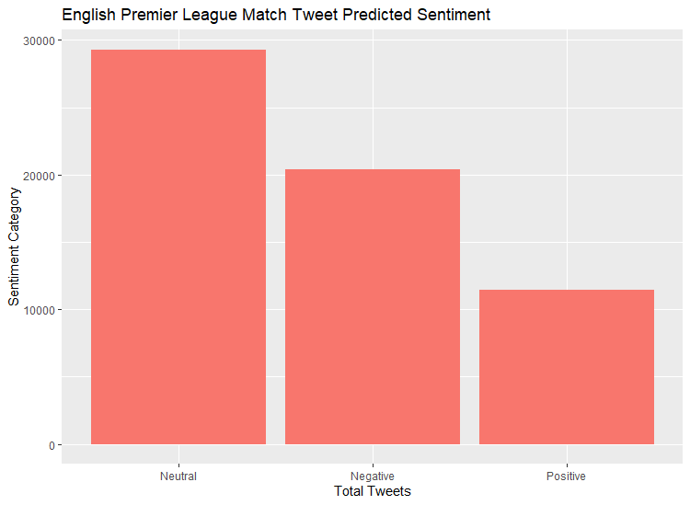
Data: NLP Predicted Sentiment
Tested model on the game-specific tweets to evaluate the predicted sentiment
Majority were neutral – many tweets simply state that a VAR decision was made
More negative sentiment than positive

Slide 22
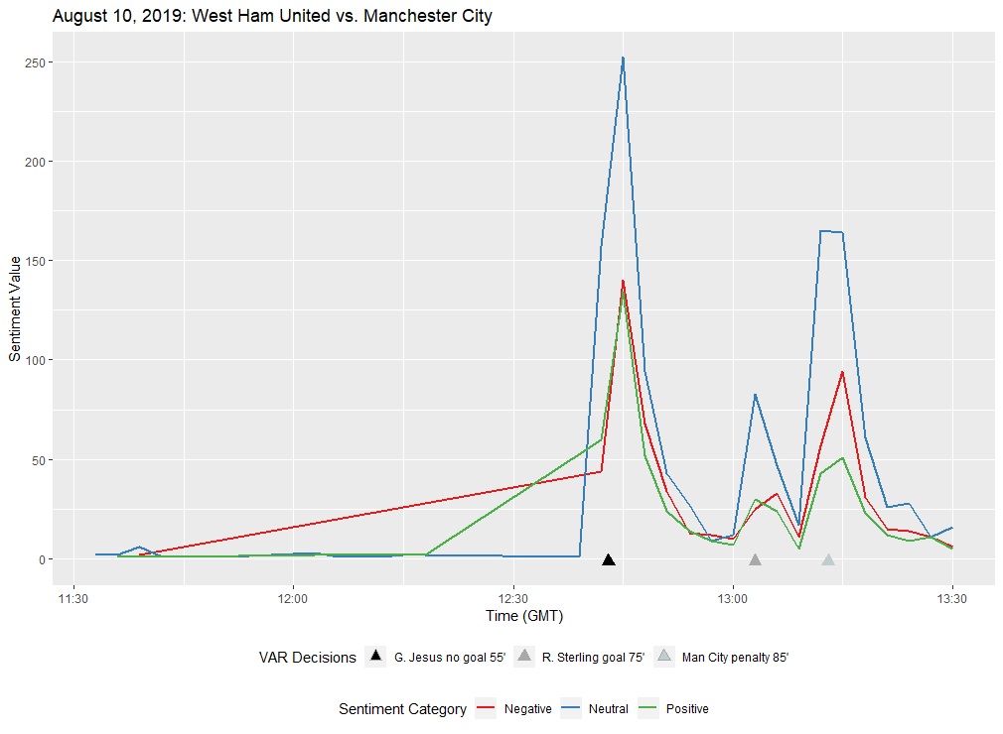
Data: Predicted Sentiment Throughout Match
Wanted to take a look at the breakdown of tweet sentiment during a match using my own model
Balanced spikes in negative and positive sentiment after the first and second calls
More negative sentiment after last decision – possibly wrong call

Slide 23
Future Work
Continue to analyze sentiment
Classify decisions as good or bad calls based on Twitter sentiment
Analyze VAR decisions in other top leagues
Look into features that may lead to more or less VAR calls
Time remaining in match
Score
Home-Field Advantage
“Better” or statistically favored team
Referees themselves

Slide 24
Conclusion
VAR decisions during a match does increase social media activity
Fans show more negativity towards the use of VAR than positivity or indifference
Areas of Improvement
Tight offsides decisions, penalty retakes, and the consistency of penalty calls
Suggestions:
Limit number of tight offsides decisions by changing the call only if a “clear and obvious” error has occurred
Increased leniency on early entry into the penalty area on spot-kicks
Time limit set on VAR decisions

Slide 25
Questions?

Slide 26
Sources
Goff, S. (2019, June 26). Analysis | VAR is working at World Cup, FIFA says. That's not wrong, but it could work better. Retrieved September 10, 2019, from https://www.washingtonpost.com/sports/2019/06/26/var-is-working-world-cup-fifa-saysthats-not-wrong-it-could-work-better/?noredirect=on.
Johnson, D. (2019, August 10). VAR in the Premier League: The big decisions explained. Retrieved August 13, 2019, from https://www.espn.com/soccer/english-premierleague/story/3917260/var-in-the-premier-league-the-big-decisions-explained.
VAR in the Premier League: How did first weekend go for technology in top flight? (2019, August 11). Retrieved August 13, 2019, from https://www.bbc.com/sport/football/49307496.
Yu, Y., & Wang, X. (2015, February 20). World Cup 2014 in the Twitter World: A big data analysis of sentiments in U.S. sports fans' tweets. Retrieved October 3, 2019, from https://www.sciencedirect.com/science/article/pii/S074756321500103X.
Corney, D., Martin, C., & Goker, A. (2014, April 13). Spot the Ball: Detecting Sports Events on Twitter. Retrieved October 3, 2019, from http://dcorney.com/papers/ECIR_SpotTheBall.pdf.
Gratch, J., Lucas, G., Malandrakis, N., Szablowski, E., Fessler, E., & Nichols, J. (2015, September 21). GOAALLL!: Using Sentiment in the World Cup to Explore Theories of Emotion. Retrieved October 5, 2019, from http://ict.usc.edu/pubs/GOAALLL! Using Sentiment in the World Cup to Explore Theories of Emotion.pdf.
Taspinar, A. (2019, November 4). TwitterScraper. Retrieved December 20, 2019, from https://github.com/taspinar/twitterscraper
Yurko, R. (2018, July 5). FCScrapR. Retrieved August 1, 2019, from https://github.com/ryurko/fcscrapR
Wasser, L., & Farmer, C. (2017, April 19). Sentiment Analysis of Colorado Flood Tweets in R. Retrieved January 8, 2020, from https://www.earthdatascience.org/courses/earthanalytics/get-data-using-apis/sentiment-analysis-of-twitter-data-r/
Mejova, Y., Srinivasan, P., & Boynton, B. (2013, February 1). GOP Primary Season on Twitter: "Popular" Political Sentiment in Social Media. Retrieved January 14, 2020, from https://dl.acm.org/doi/10.1145/2433396.2433463
Beal, V. (n.d.). Huge List of Texting and Online Chat Abbreviations. Retrieved September 15, 2019, from https://www.webopedia.com/quick_ref/textmessageabbreviations.asp
TweetTokenizer. (n.d.). Retrieved September 15, 2019, from https://kite.com/python/docs/nltk.TweetTokenizer
Hutto, C. J. (2019, September 6). VADER Sentiment Analysis. Retrieved September 15, 2019, from https://github.com/cjhutto/vaderSentiment

